Slide 1
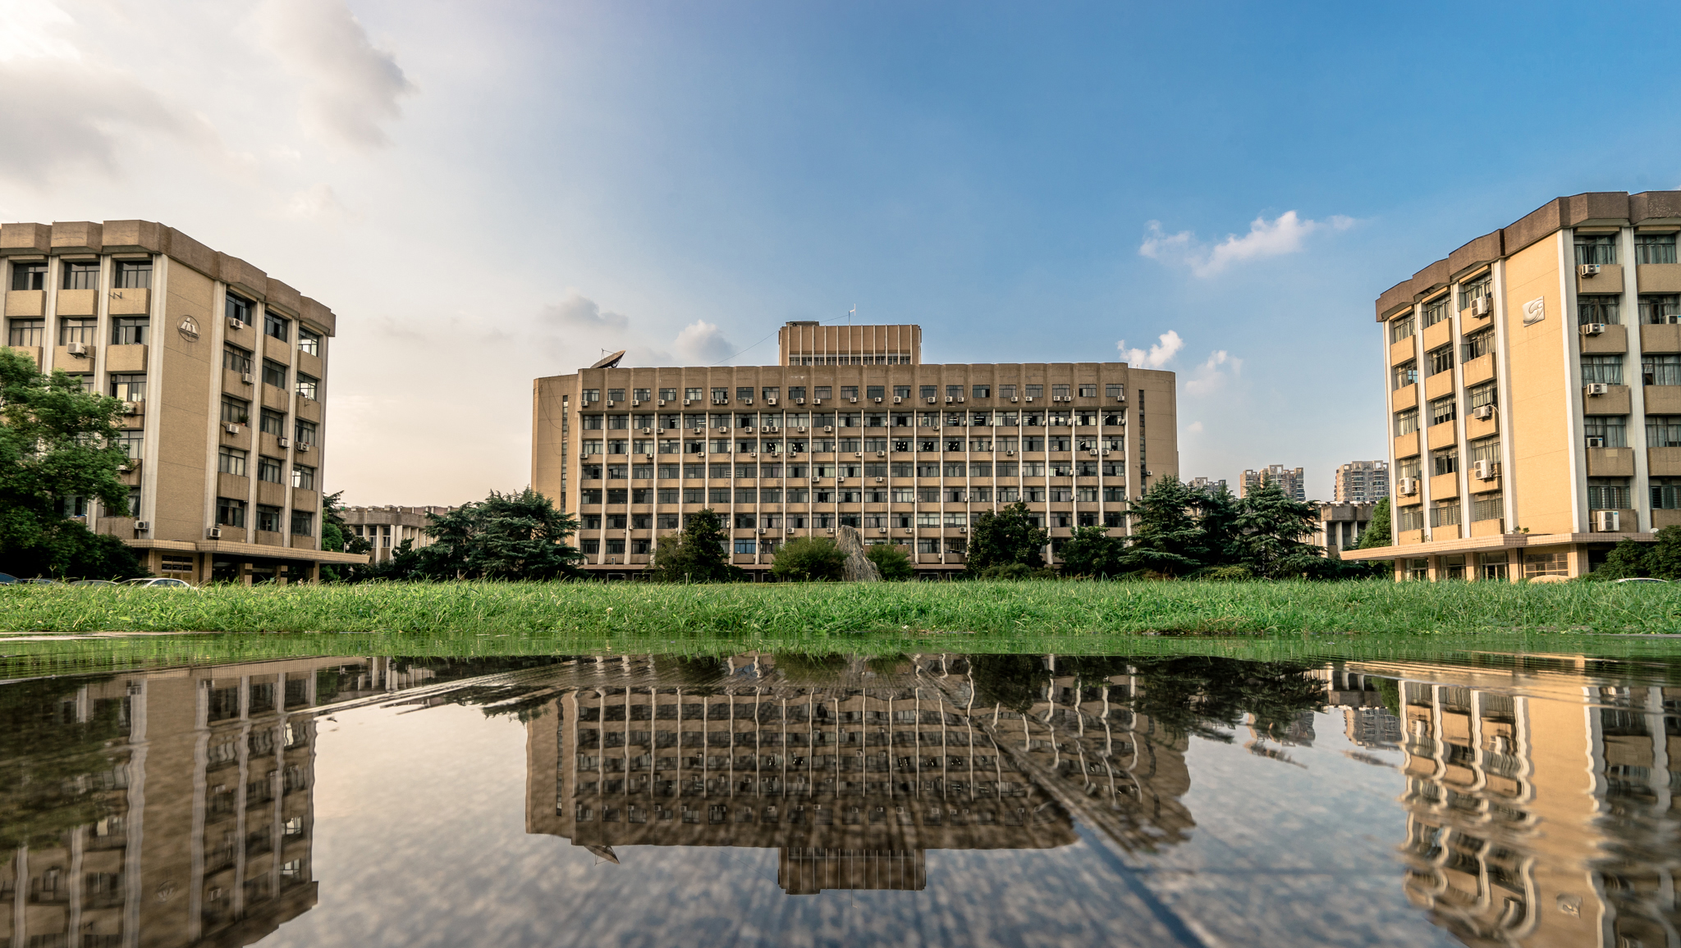



Comparison of the single-source shortest-path algorithm
输入你的副标题
QIMING HUANG
ZJUTER
艰苦创业 开拓创新 争创一流

Slide 2


01
requirement analysis
目录
02
AGENDA
item design
03
cooperation
04
Production testing
- 艰苦创业 开拓创新 争创一流 -

Slide 3
requirement analysis
Dijkstra
Algorithms
Bellman
SPFA
Connection Design
Encapsulated as an object
input
GUI
choice
canvas
厚德健行

Slide 4
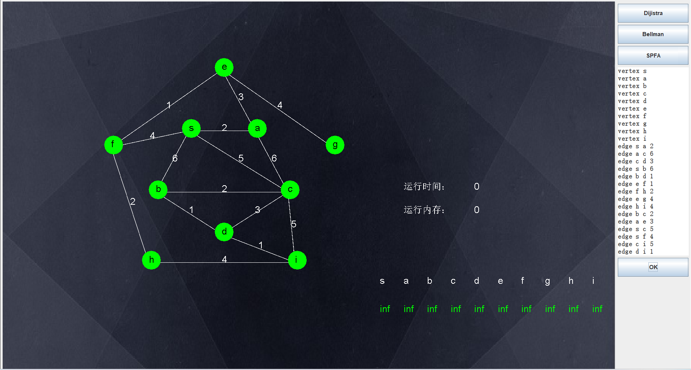
GUI Design
Choice button
Graph input text area
Graph Showing Canvas
厚德健行

Slide 5
Code Design
GUI class
Painting Class
Dijkstra Class
JAVA
SPFA Class
Bellman Class
Connection Class
厚德健行

Slide 6
输入你的小标题
Two people are responsible for the algorithm
Two people are responsible for the Painting Canvas
1
2
One people are responsible for Designing Code and Integrate code
One person are responsible for writing text and make PPT
3
2
厚德健行

Slide 7
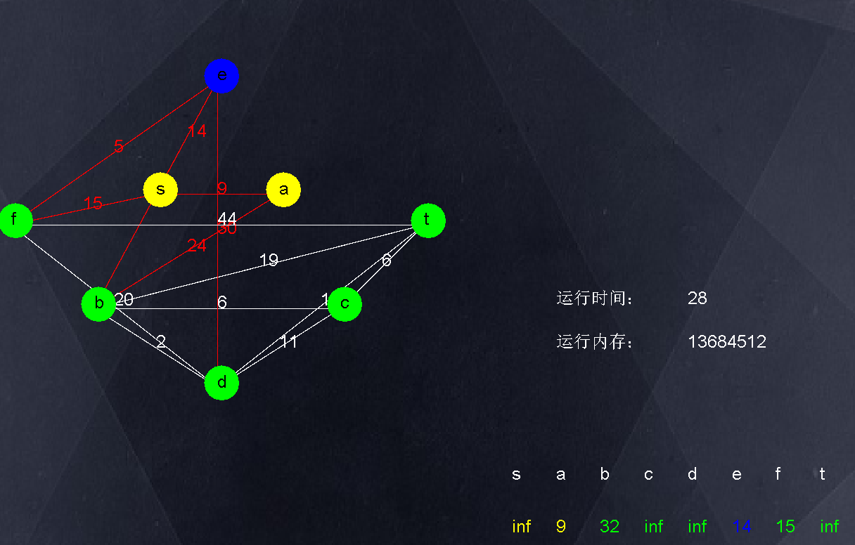
Production testing
We using many different graphs to test our code
厚德健行

